Slide 1
Data Mining Samah Fodeh
1
Notes:
1

Slide 2
Data Mining
is the process of analyzing data from different perspectives and summarizing it into useful information
Data mining methods: Classification, clustering, outlier detection, graph mining, summarization…
Some application domains
Financial data analysis
Biological data analysis
Clinical data analysis

Slide 3
Supervised vs. Unsupervised Learning
Supervised learning (classification)
The training data (observations, measurements, etc.) are accompanied by labels indicating the class of the observations
Build a model using this data
Predict labels of New/ Unseen observation using the model.
Unsupervised learning (clustering)
The class labels of training data is unknown
Given a set of measurements, observations, etc. with the aim of establishing the existence of classes or clusters in the data

Slide 4
Classification—A Two-Step Process
Model construction:
Split labeled data into training and test datasets
Training dataset is used to build the model
The model is represented as classification rules, decision trees, or mathematical formulae
Model evaluation: for classifying test dataset or future /unknown objects
Apply the model to the test set
The known label of test sample is compared with the classified result from the model
Test set is independent of training set (otherwise overfitting)
If the accuracy is acceptable, use the model to classify new data

Slide 5
Process (1): Model Construction
Classification
Algorithms
Training
Data
Classifier
(Model)
IF rank = ‘professor’
OR years > 6
THEN tenured = ‘yes’

Slide 6
Process (2): Using the Model in Prediction
Classifier
Testing
Data
Unseen Data
(Jeff, Professor, 4)
Tenured?

Slide 7
Naïve Bayes Classifier
A statistical classifier: performs probabilistic prediction, i.e., predicts class membership probabilities
Foundation: Based on Bayes’ Theorem which computes the probability of an event, based on prior knowledge of conditions that might be related to the event
For example, if cancer is related to age, then, using Bayes’ theorem, a person’s age can be used to more accurately assess the probability that he have cancer

Slide 8
Classification Is to Derive the Maximum Posteriori
Let D be a training set of examples and their associated class labels
Each example is represented by an n-dimensional attribute vector X = (x₁, x₂, …, x_{n})
Suppose there are m classes C₁, C₂, …, C_{m}.
Classification is to derive the maximum posteriori, i.e., the maximal P(C_{i}|X) using Bayes’ theorem
posteriori = (likelihood x prior)/evidence →
Since P(X) is constant for all classes, only
needs to be maximized

Slide 9
Naïve Bayes Classifier
A simplified assumption: attributes are conditionally independent (i.e., no dependence relation between attributes):
This greatly reduces the computation cost: Only counts the class distribution
If X_{k} is categorical, P(x_{k}|C_{i}) is the # of instances that have value x_{k} and belong to class C_{i,} divided by, the number of C_{i} instances in the data.
If X_{k} is continous-valued, P(x_{k}|C_{i}) is usually computed based on Gaussian distribution with a mean μ and standard deviation σ
and P(x_{k}|C_{i}) is

Slide 10
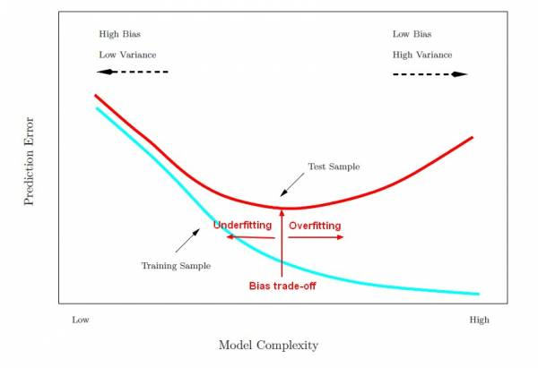
Overfitting
Overfitting: a classification model may overfit the training data
Too many branches, some may reflect anomalies due to noise or outliers
Poor accuracy for unseen samples

Slide 11
Model Engineering
Model Evaluation Metrics
Model Evaluation & Data Management
Model Enhancement
Model selection

Slide 12
Model Evaluation Metrics
A\P | C | ¬C
C | TP | FN | P
¬C | FP | TN | N
 | P’ | N’ | All
Sensitivity: True Positive recognition rate
Sensitivity = TP/P
Specificity: True Negative recognition rate
Specificity = TN/N
Class Imbalance Problem:
One class may be rare, e.g. fraud, or HIV-positive
F measure (F1 or F-score): harmonic mean of precision and recall
Classifier Accuracy, or recognition rate: percentage of test set tuples that are correctly classified
Accuracy = (TP + TN)/All
Error rate: 1 – accuracy, or
Error rate = (FP + FN)/All
12

Slide 13
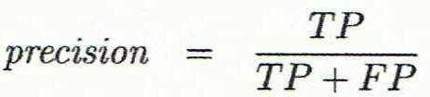
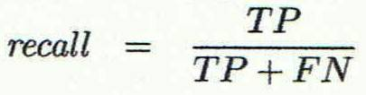
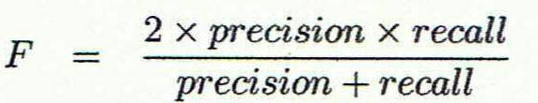
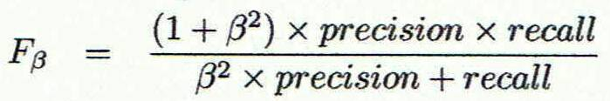
Model Evaluation Metrics
Precision: exactness – what % of tuples that the classifier labeled as positive are actually positive
Recall: completeness – what % of positive tuples did the classifier label as positive?
Perfect score is 1.0
Inverse relationship between precision & recall
F measure (F₁ or F-score): harmonic mean of precision and recall,
F_{ß}: weighted measure of precision and recall
assigns ß times as much weight to recall as to precision
13

Slide 14
Model Engineering
Model Evaluation Metrics
Model Robustness & Data Management
Model Enhancement
Model selection

Slide 15
Model Robustness & Data Management
Methods for evaluating /estimating a classifier’s performance:
Holdout method
Cross-validation
Bootstrap
15

Slide 16
Model Robustness & Data Management
Holdout method
Given data is randomly partitioned into two independent sets
Training set (e.g., 2/3) for model construction
Test set (e.g., 1/3) for accuracy estimation
Cross-validation (k-fold, where k = 10 is most popular)
Randomly partition the data into k mutually exclusive subsets, each approximately equal size
At i-th iteration, use D_{i} as test set and others as training set
Leave-one-out: k folds where k = # of tuples, for small sized data
*Stratified cross-validation*: folds are stratified so that class dist. in each fold is approx. the same as that in the initial data
16

Slide 17
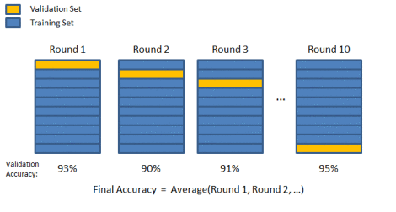
Cross Validation

Slide 18
Model Robustness & Data Management
Bootstrap
Used for small data sets
The bootstrap was introduced as a general method for assessing the statistical accuracy of an estimator
Samples the given training points uniformly with replacement
i.e., each time a data point is selected, it is equally likely to be selected again and re-added to the training set
A data set with d points is sampled d times, with replacement, resulting in a training set of d points.
18

Slide 19
An example
X1=(1.57,0.22,19.67,
0,0,2.2,3.12)
Mean=4.13
X=(3.12, 0, 1.57,
19.67, 0.22, 2.20)
X2=(0, 2.20, 2.20,
2.20, 19.67, 1.57)
Mean=4.46
Mean=4.64
X3=(0.22, 3.12,1.57,
3.12, 2.20, 0.22)
Mean=1.74

Slide 20
Procedure for bootstrapping
Let the original sample be x=(x₁,x₂,…,x_{n})
Repeat B times
Generate a sample x* of size n from x by sampling with replacement.
Compute for x*.
➔ Now we end up with bootstrap values
Use these values for calculating the quantities of interest (e.g., standard deviation, confidence intervals)

Slide 21
Model Engineering
Model Evaluation Metrics
Model Robustness & Data Management
Model Enhancement
Model selection

Slide 22
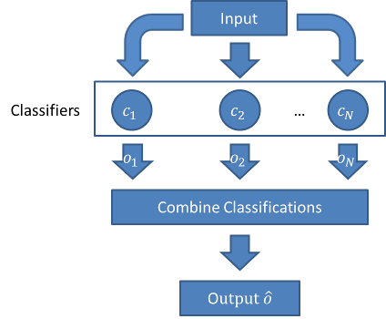
Model Enhancement
Ensemble learning: Use a combination of models to improve performance
Combine a series of k learned models, C₁, C₂, …, C_{k}, with the aim of creating an improved model C*
22

Slide 23
Model Enhancement
Ensemble methods
Bagging: averaging the prediction over a collection of classifiers
Boosting: weighted vote with a collection of classifiers
Ensemble: combining a set of heterogeneous classifiers
Random Forest
AdaBoost

Slide 24
Bagging: Bootsrap Aggregation
Training
Bootstrap: Given a set D of d points, at each iteration i, a training set D_{i} of d points is sampled with replacement from D
A classifier model M_{i} is learned for each sample D_{i} of the bootstrap
Classification: classify an unknown sample X
Each classifier M_{i} returns its class prediction
The bagged classifier M* counts the votes and assigns the class with the most votes to X
Prediction: for a given test point, assign the class with the majority of votes
Accuracy
Increases classifier stability/reduces variance
Often significantly better than a single classifier derived from D
Proved improved accuracy in prediction
24

Slide 25
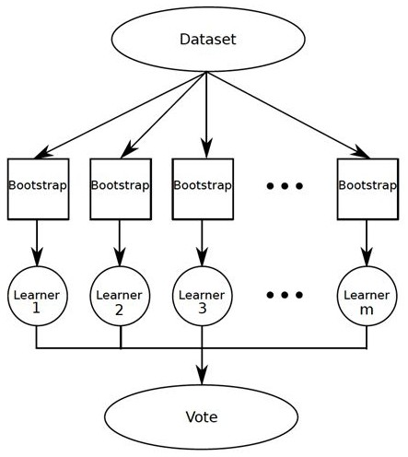
Bagging

Slide 26
Boosting
Analogy: Consult several doctors, based on a combination of weighted diagnoses—weight assigned based on the previous diagnosis accuracy
Main idea: Combine many weak classifiers to produce a powerful committee
How boosting works?
Weights are assigned to each training point
A series of k classifiers is iteratively learned
Learn classifier M_{i}
Update the weights of the data points to allow the subsequent classifier, M_{i+1}, to pay more attention to the training points that were misclassified by M_{i}
The final M* combines the votes of each individual classifier, where the weight of each classifier's vote is a function of its accuracy
Comparing with bagging: Boosting tends to have greater accuracy, but it also risks overfitting the model to misclassified data
26

Slide 27
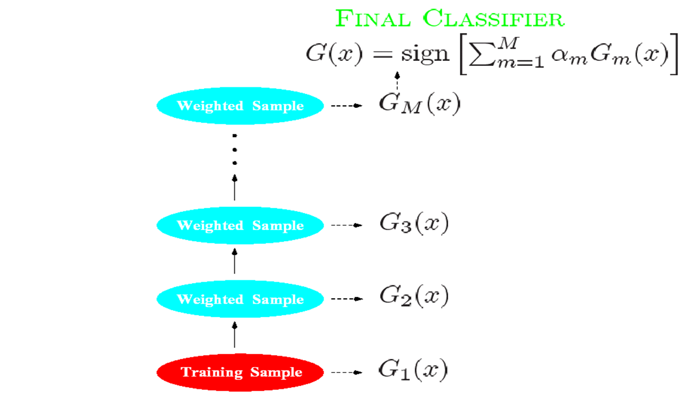
Boosting

Slide 28
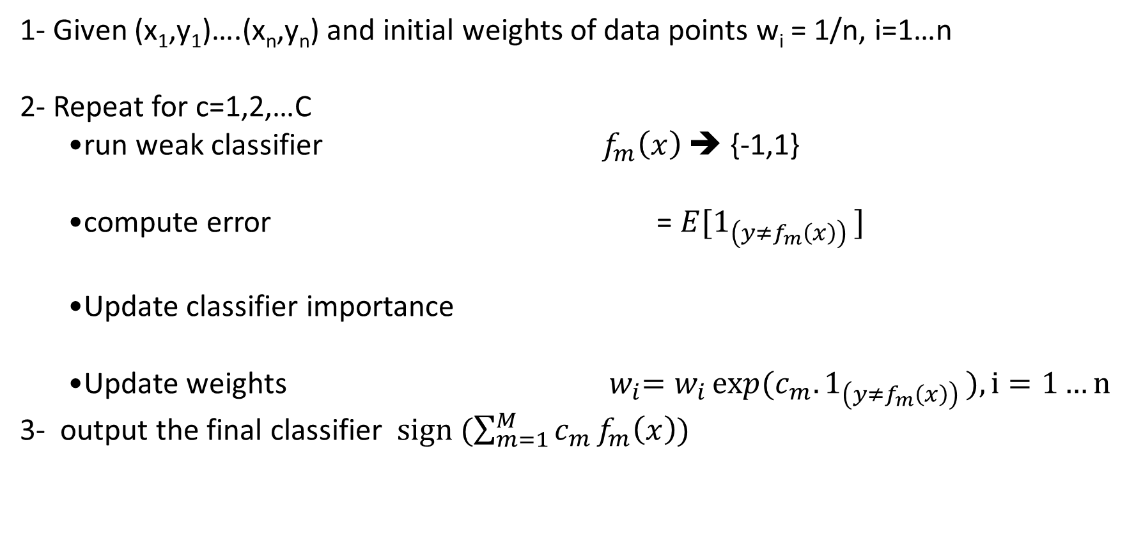
AdaBoost
1- Given (x₁,y₁)….(x_{n},y_{n}) and initial weights of data points w_{i} = 1/n, i=1…n
2- Repeat for c=1,2,…C
run weak classifier $f_{m}\left(x\right)$ ➔ {-1,1}
compute error = $E[1_{\left(y≠f_{m}\left(x\right)\right) }]$
Update classifier importance
Update weights ${ w}_{i}=w_{i}\exp{(c_{m}.1_{\left(y≠f_{m}\left(x\right)\right) }}), i=1…n$
3- output the final classifier $sign (\sum_{m=1}^{M}{c_{m}}f_{m}\left(x\right))$

Slide 29
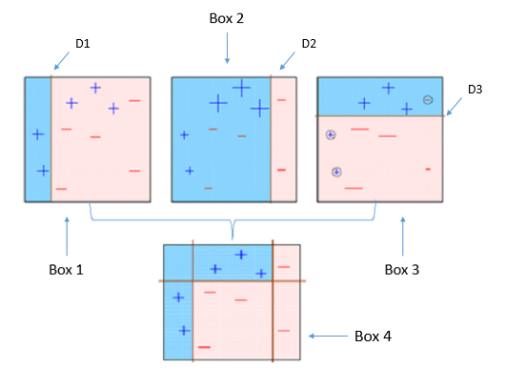
AdaBoost

Slide 30
Random Forest
A forest of n trees
→Each trees is a classifier built using a bootstrap sample
→ within a tree, at each node:
Select m variables at random
Find the best feature to split the tree
→ to predict a label of new data:
average/vote the predictions of all trees in the forest

Slide 31
Random Forest vs. AdaBoost
Random Forest is comparable in accuracy to Adaboost, but more robust to errors and outliers
Insensitive to the number of attributes selected for consideration at each split, and faster than bagging or boosting

Slide 32
Model Engineering
Model Evaluation Metrics
Model Robustness & Data Management
Model Enhancement
Model selection

Slide 33
Model selection
compare classifiers performance :
Confidence intervals
ROC Curve
33

Slide 34


Compare Classifier Performance
Suppose we have 2 classifiers, M₁ and M₂, which one is better?
Use 10-fold cross-validation to obtain and
These mean error rates are just estimates of error on the true population of future data cases
What if the difference between the 2 error rates is just attributed to chance?
Use a test of statistical significance
Obtain confidence limits for our error estimates
34

Slide 35
Estimating Confidence Intervals: Null Hypothesis
Perform 10-fold cross-validation
Compute err(M₁) & err(M₂) for each fold
Assume samples follow a t distribution with k–1 degrees of freedom (here, k=10)
Use t-test (or Student’s t-test)
Null Hypothesis: mean error rates of M₁ & M₂ are the same
If we reject null hypothesis, then
we conclude that the difference between M₁ & M₂ is statistically significant
Choose model with lower error rate
35

Slide 36
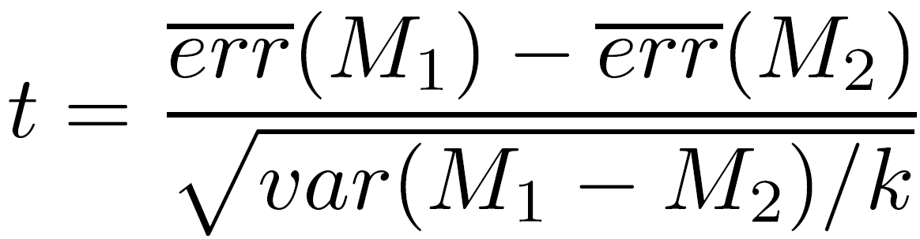
Estimating Confidence Intervals: t-test
For i^{th} round of 10-fold cross-validation obtain err(M₁)_{i} and err(M₂)_{i}
Average over 10 rounds to get
t-test ➔
and
where
36

Slide 37
Estimating Confidence Intervals: Statistical Significance
Consult table for t-distribution:
Find t value corresponding to k-1 degrees of freedom (here, 9) at significance level .05
t-distribution is symmetric: typically upper % points of distribution shown → look up value for confidence limit z=sig/2 (here, 0.025)
If t > z or t < -z, then t value lies in rejection region:
Reject null hypothesis that mean error rates of M₁ & M₂ are same
Conclude: statistically significant difference between M₁ & M₂
Otherwise, conclude that any difference is chance
37

Slide 38
Model Selection: ROC Curves
ROC (Receiver Operating Characteristics) curves: for visual comparison of classification models
Shows the trade-off between the true positive rate and the false positive rate
The area under the ROC curve is a measure of the accuracy of the model
Rank the test examples in decreasing order: the one that is most likely to belong to the positive class appears at the top of the list
The closer to the diagonal line (i.e., the closer the area is to 0.5), the less accurate is the model
A model with perfect accuracy will have an area of 1.0
38

Slide 39
Multi-class classification
Binary classification (DONE)
Data has multiple classes; more than 2
Each data point could be assigned one class only

Slide 40


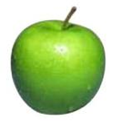
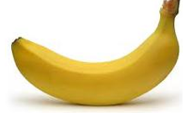
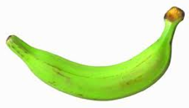

Multiclass classification
examples
label
Same setup where we have a set of features for each example
Rather than just two labels, now have 3 or more
apple
orange
apple
banana
banana
pineapple

Slide 41
Multiclass classification
Hard to separate three classes with just one line ☹

Slide 42
Multiclass classification
Can we use a binary classifier to construct a multiclass classifier?
Decompose the prediction into multiple binary decisions
How to decompose?
One-vs-All
All-vs-All

Slide 43
Visualizing One-vs-all
From the full dataset, construct three binary classifiers, one for each class
w_{blue}^{T}x > 0 for blue inputs
w_{red}^{T}x > 0 for red inputs
w_{green}^{T}x > 0 for green inputs
Notation: Score for blue label
Winner Take All will predict the right answer. Only the correct label will have a positive score

Slide 44
One-vs-All classification
Assumption: Each class individually separable from all the others
Learning: Given a dataset D = {<x_{i}, y_{i}>}, y_{i} ➔ {1, 2, ☹, K}
Decompose into K binary classification tasks
For class k, construct a binary classifier such that:
Positive examples: Elements of D with label k
Negative examples: All other elements of D
Train K binary classifiers w₁, w₂, ☹ w_{K} using any classification algorithm
Prediction: “Winner Takes All”
argmax_{i} w_{i}^{T}x
Question: What is the dimensionality of each w_{i}?

Slide 45
One-vs-All may not always work
Black points are not separable with a single binary classifier
The decomposition will not work for these cases!
w_{blue}^{T}x > 0 for blue inputs
w_{red}^{T}x > 0 for red inputs
w_{green}^{T}x > 0 for green inputs
???

Slide 46
One-vs-One classification
Also called All-vs-All
Assumption: Every pair of classes is separable
Learning: Given a dataset D = {<x_{i}, y_{i}>}, y_{i} → {1, 2, ☹, K}
For every pair of labels (j, k), create a binary classifier with:
Positive examples: All examples with label j
Negative examples: All examples with label k
Train classifiers in all
Prediction: More complex
How to combine the votes? Many methods
Majority: Pick the label with maximum votes

Slide 47
One-vs-One classification
Every pair of labels is linearly separable here
When a pair of labels is considered, all others are ignored
Problems
K(k-1)/2 weight vectors to train and store
Size of training set for a pair of labels could be very small, leading to overfitting

Slide 48
Unsupervised Learning (Clustering)
finding a partition of the data into groups (clusters) such that members in a cluster are more similar to each other than to other members in different clusters.

Slide 49
Document Representation
 | Computer | the | lab | to | soccer | game | …....
Doc1 | 1 | 0 | 1 | 0 | 0 | 0 | . . . . . . .
Doc2 | 1 | 2 | 1 | 2 | 0 | 0 | . . . . . . .
Doc3 | 0 | 0 | 0 | 0 | 1 | 1 | . . . . . . .
Doc4 | 0 | 0 | 0 | 0 | 0 | 1
Doc5 | 0 | 0 | 0 | 0 | 1 | 0

Slide 50

K-means Algorithm
Given the cluster number K, the K-means algorithm is carried out in three steps
Initialization: set seed points (randomly)
Assign each object to the cluster of the nearest seed point measured with a specific distance metric
Compute new seed points as the centroids of the clusters of the current partition (the centroid is the centre, i.e., mean point, of the cluster)
Go back to Step 1), stop when no more new assignment (i.e., membership in each cluster no longer changes)

Slide 51
Ensemble Clustering
The goal of ensemble clustering is to capture the consensus on grouping similar objects in one cluster
K-means is repeatedly run to produce different partitions or clusters
Build incidence matrix for each k-means portioning solution (which encounters pairs of instances falling in the same cluster)
Aggregate the incidence matrices into the co-association matrix which is in turn clustered to obtain the final partition

Slide 52
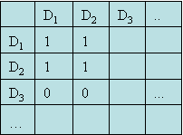
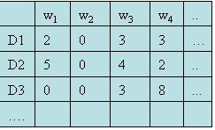
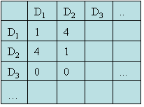
Combined Ensemble Clustering
Incidence matrix
Co-association
matrix
kmeans

